Slide 1
Lecture 6: Sampling designs

Slide 2
Optimal predictions and bias correction

Slide 3
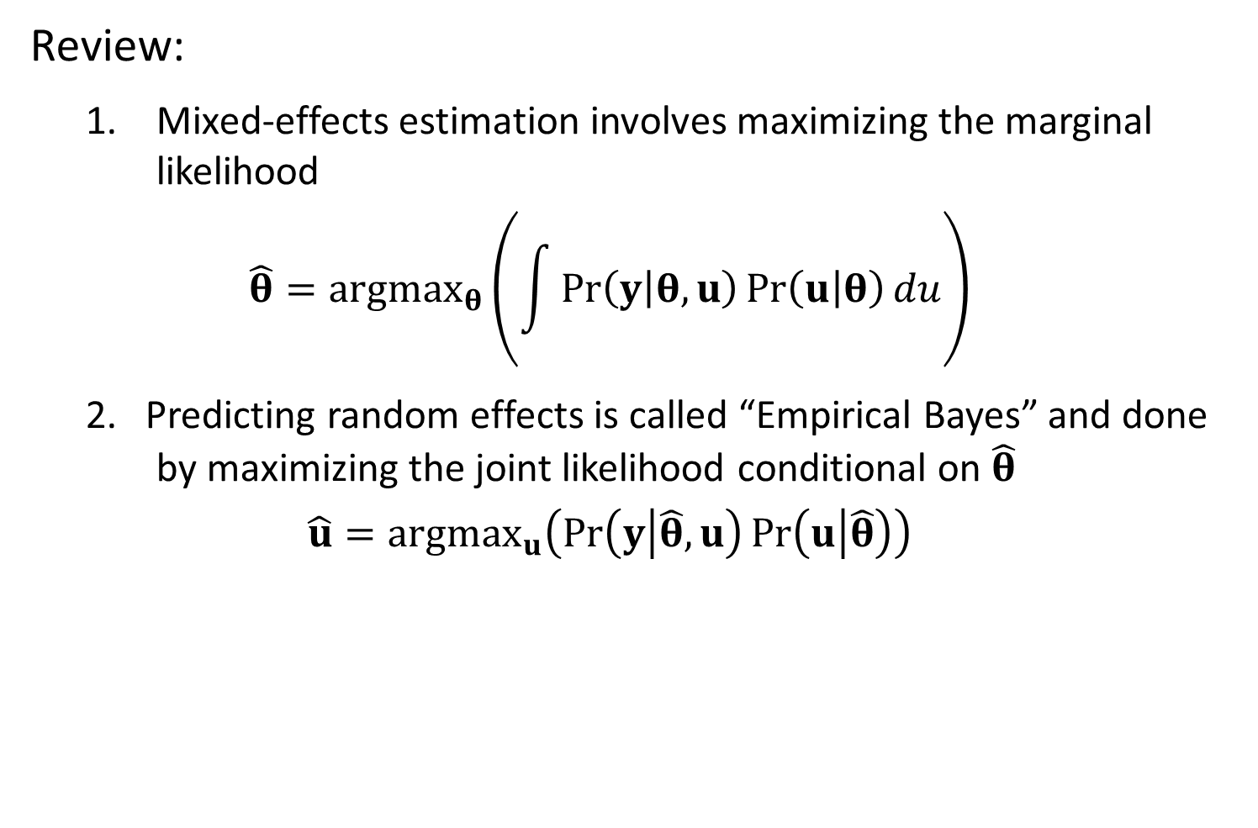
Review:
Mixed-effects estimation involves maximizing the marginal likelihood
$$\hat{θ}={argmax}_{θ}\left(\int{\operatorname{Pr}\left(y | θ,u\right)\operatorname{Pr}\left(u | θ\right)du}\right)$$
2. Predicting random effects is called “Empirical Bayes” and done by maximizing the joint likelihood conditional on $\hat{θ}$
$$\hat{u}={argmax}_{u}\left(\operatorname{Pr}\left(y | \hat{θ},u\right)\operatorname{Pr}\left(u | \hat{θ}\right)\right)$$

Slide 4
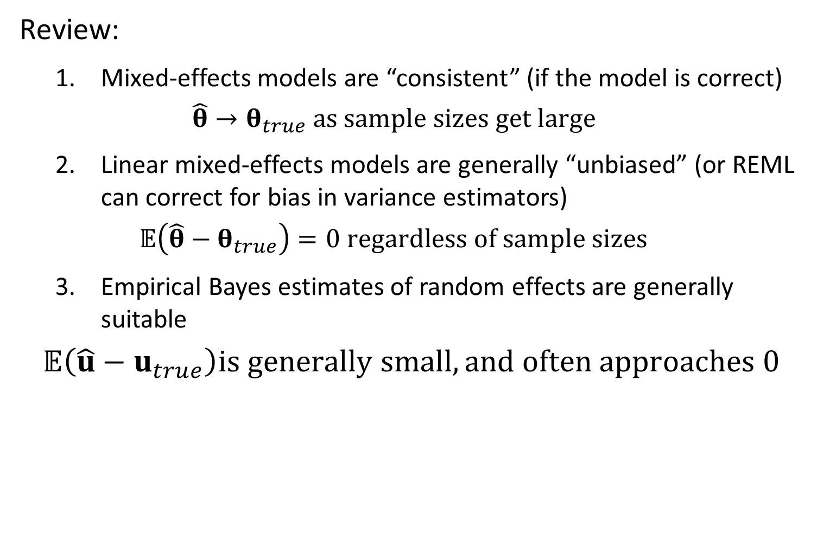
Review:
Mixed-effects models are “consistent” (if the model is correct)
$$\hat{θ}→θ_{true} as sample sizes get large$$
Linear mixed-effects models are generally “unbiased” (or REML can correct for bias in variance estimators)
$$𝔼\left(\hat{θ}−θ_{true}\right)=0 regardless of sample sizes$$
Empirical Bayes estimates of random effects are generally suitable
$$𝔼\left(\hat{u}−u_{true}\right)is generally small, and often approaches 0$$

Slide 5
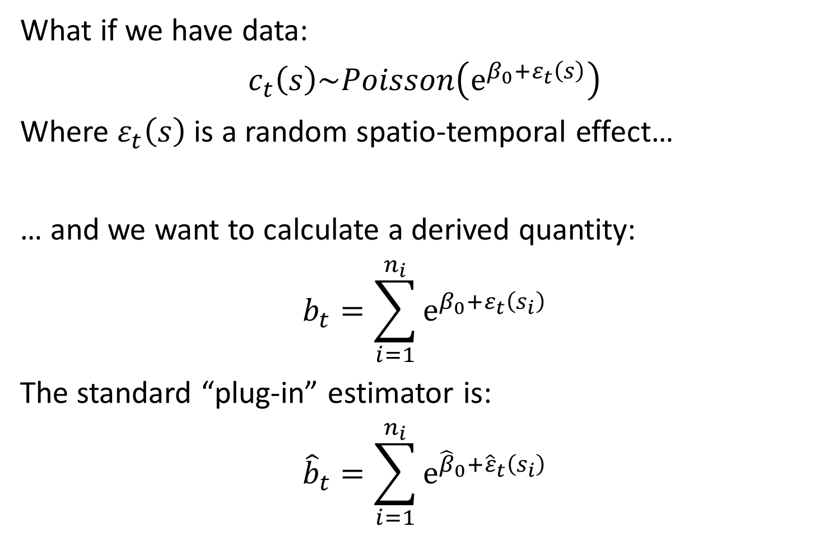
What if we have data:
$$c_{t}\left(s\right)\sim Poisson\left(e^{β_{0}+ε_{t}\left(s\right)}\right)$$
Where $ε_{t}\left(s\right)$ is a random spatio-temporal effect…
… and we want to calculate a derived quantity:
$$b_{t}=\sum_{i=1}^{n_{i}}{e^{β_{0}+ε_{t}\left(s_{i}\right)}}$$
The standard “plug-in” estimator is:
$${\hat{b}}_{t}=\sum_{i=1}^{n_{i}}{e^{{\hat{β}}_{0}+{\hat{ε}}_{t}\left(s_{i}\right)}}$$

Slide 6
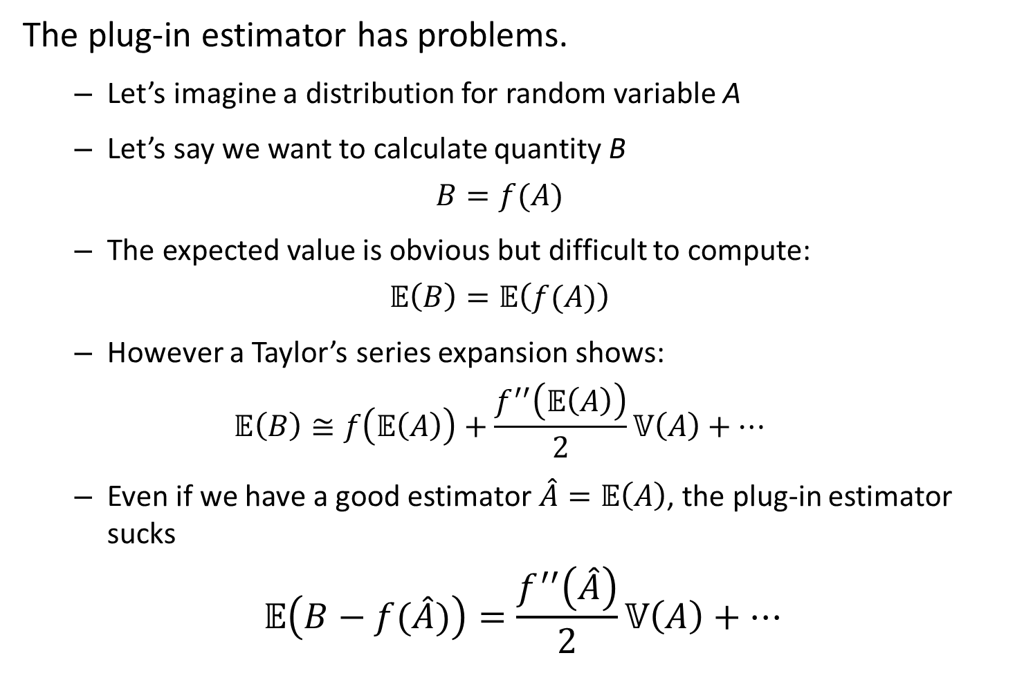
The plug-in estimator has problems.
Let’s imagine a distribution for random variable A
Let’s say we want to calculate quantity B
$$B=f(A)$$
The expected value is obvious but difficult to compute:
$$𝔼\left(B\right)=𝔼\left(f(A)\right)$$
However a Taylor’s series expansion shows:
$$𝔼\left(B\right)≅f\left(𝔼\left(A\right)\right)+\frac{f^{′′}\left(𝔼\left(A\right)\right)}{2}𝕍\left(A\right)+…$$
Even if we have a good estimator $\hat{A}=𝔼\left(A\right)$, the plug-in estimator sucks
$$𝔼\left(B−f(\hat{A})\right)=\frac{f^{′′}\left(\hat{A}\right)}{2}𝕍\left(A\right)+…$$

Slide 7
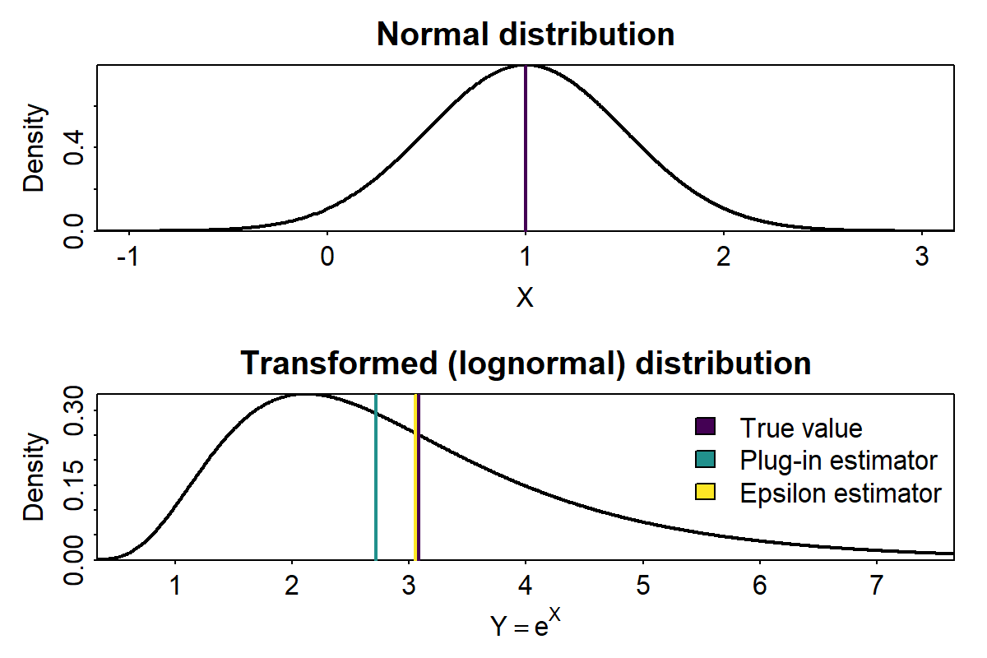
The plug-in estimator has problems.

Slide 8
Sampling designs

Slide 9
Probability sampling
Define sampling units
Define sampling frame as set of units, which covers population to sample
Assign sampling probability to each unit
Weight samples by inverse of sampling probabilities

Slide 10
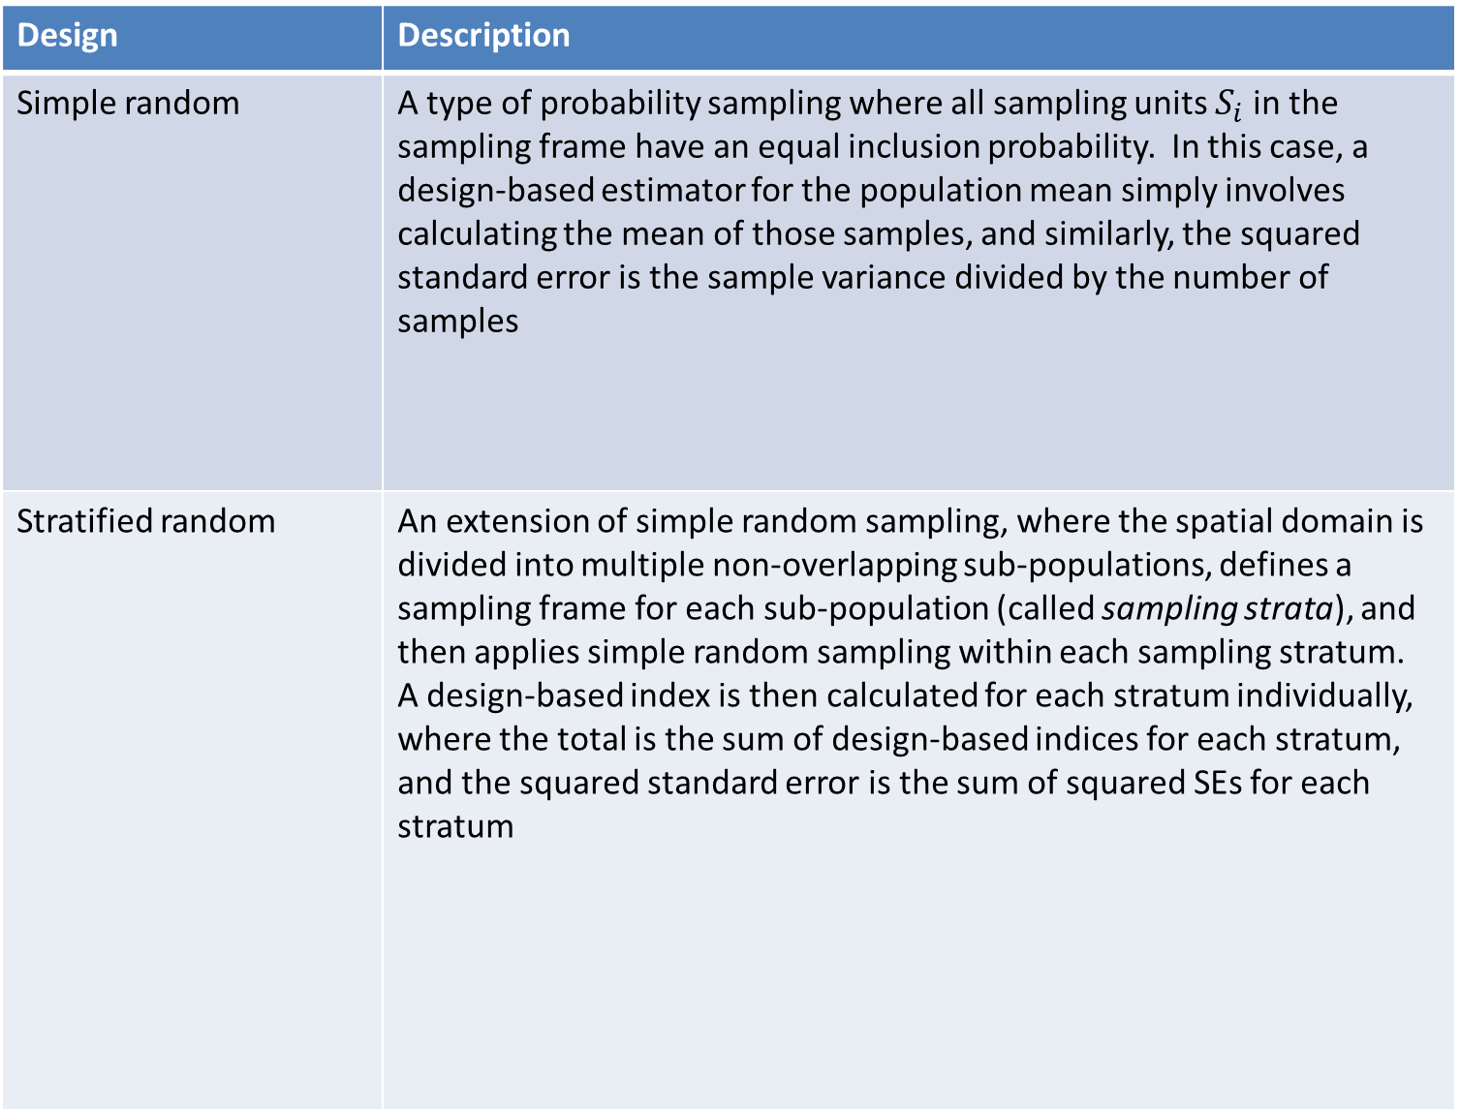
Design | Description
Simple random | A type of probability sampling where all sampling units $S_{i}$ in the sampling frame have an equal inclusion probability. In this case, a design-based estimator for the population mean simply involves calculating the mean of those samples, and similarly, the squared standard error is the sample variance divided by the number of samples
Stratified random | An extension of simple random sampling, where the spatial domain is divided into multiple non-overlapping sub-populations, defines a sampling frame for each sub-population (called sampling strata), and then applies simple random sampling within each sampling stratum. A design-based index is then calculated for each stratum individually, where the total is the sum of design-based indices for each stratum, and the squared standard error is the sum of squared SEs for each stratum

Slide 11
Design | Description
Systematic | Defining an order for sampling units and then sampling at some pre-defined frequency along that order. If sampling units are ordered spatially, then systematic sampling ensures that samples are evenly spread across space and thereby can improve sampling precision in some cases. However, a different set of design-based estimators are appropriate to calculate the population mean and standard error
Fixed station (a.k.a. panel) | Identifying a set of sampling units that are repeatedly sampled over time. In this case, inference from samples to the population presumably requires that the fixed stations are representative, or that they are rotated periodically following a probability design (sometimes called a \textit{rotating panel design}). In other cases, ecologists might select sites such that they can be intensively studied over time, and processes at each site are assumed to be representative of ecological processes in general, e.g., how inference is made from Long-Term Ecological Research network sites to global ecological processes

Slide 12
Design | Description
Two-stage (multi-level) | When sampling the density of a population that is highly clustered, ecologists often conduct some probability or systematic sample for primary sampling units across the entire sampling frame, and then conduct secondary sampling in secondary sampling units within those primary units. For example, secondary sampling might be higher in the vicinity of individuals detected in the first stage. Design-based estimators typically involve calculating the mean and variance in each primary sampling unit based on secondary sampling, and applying an estimator across primary sampling units
Opportunistic | Analyzing data that arise from some process that the analyst does not control and hence cannot randomize (or perhaps even fully document). For example, continuous-plankton records have been collected opportunistically on ocean-going vessels for many decades, and the Christmas Bird Count has involved citizen-scientists sampling birds. In general, there is no design-based estimator for these data that do not follow a design, so inference has historically involved proposing a model and using model-based inference

Slide 13
Expansion weighting

Slide 14
Weighting method | Purpose
Sample weighting | Only if samples are of interest
Area weighting | When calculating a total over some domain
Covariate weighting | Calculate average habitat utilization (e.g., shifts in distribution, depth, elevation, etc)
Abundance weighting | Calculate average of some mark, i.e., body size, condition

Slide 15
Occupancy models

Slide 16
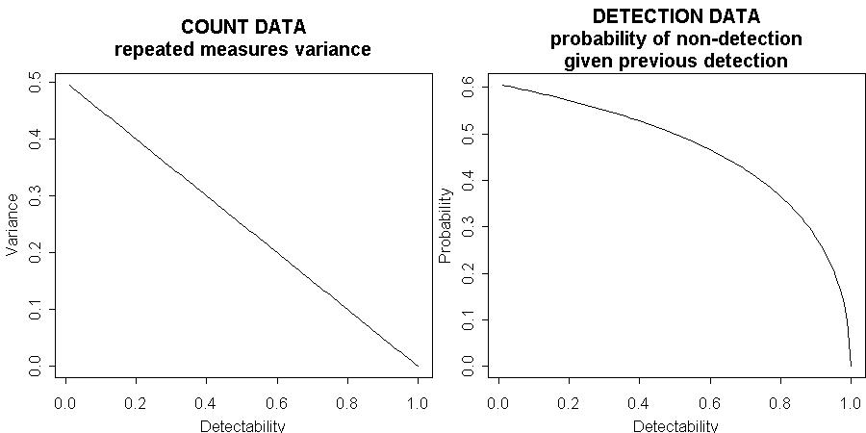

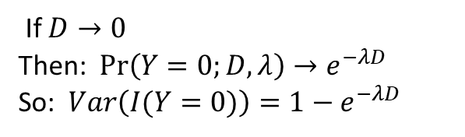
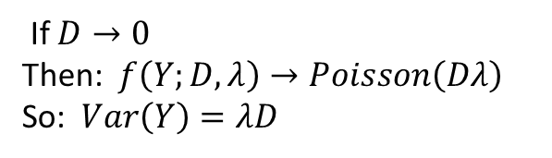
Estimating detectability
$λ×q=0.5$ where $λ$ is density and $q$ is detectability
If $D→0$
Then: $f\left(Y;D,λ\right)→Poisson\left(Dλ\right)$
So: $Var\left(Y\right)=λD$
If $D→0$
Then: $Pr\left(Y=0;D,λ\right)→e^{−λD}$
So: $Var\left(I(Y=0)\right)=1−e^{−λD}$

Slide 17
Assumptions
Multi-level sampling design with sites (primary) and samples within site (secondary)
Secondary sampling has “demographic closure”
No change in abundance
Individuals are homogenous and independently encountered in each secondary sample

